Slide 1


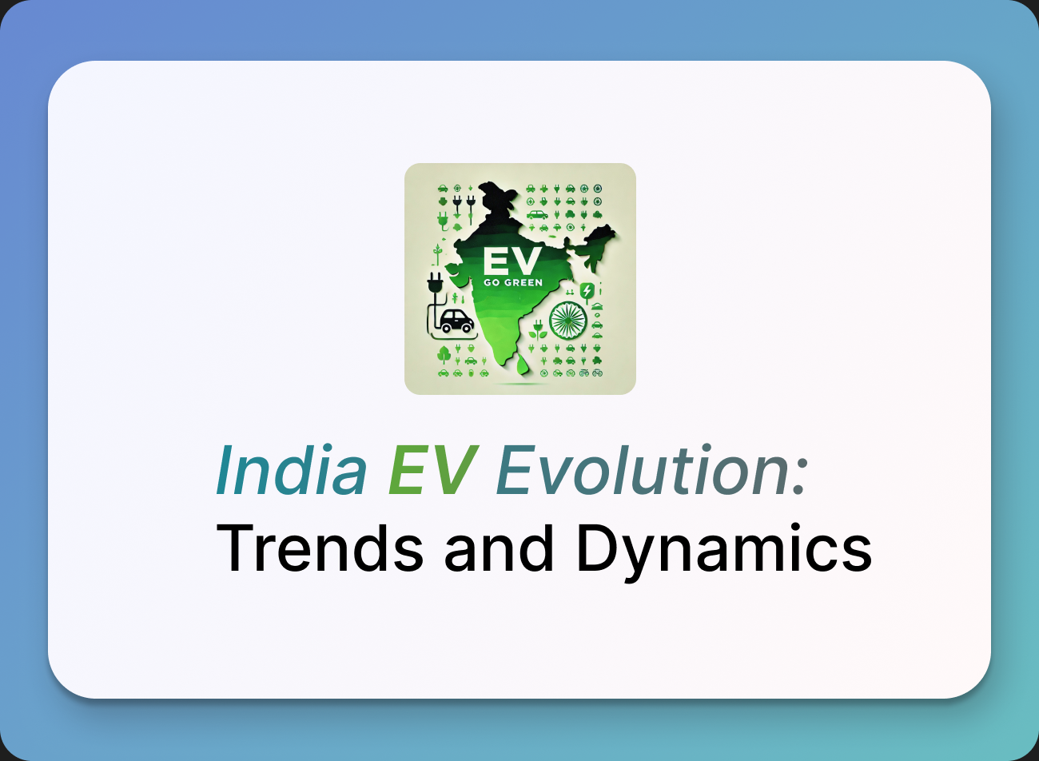

Resume Project Challenge #12
Presented By:
Nagendra Vallepu

Slide 2
AGENDA
PROBLEM STATEMENT
BACKGROUND
PROJECT OVERVIEW
DASHBOARD
PRIMARY QUESTIONS
SECONDARY QUESTIONS
RECOMMENDATION
REFERENCES

Slide 3
PROBLEM STATEMENT
AtliQ Motors, a leading automotive manufacturer from the USA, has successfully captured a 25% market share in the electric and hybrid vehicle segment in North America over the past 5 years.
As part of their global expansion strategy, AtliQ Motors aims to penetrate the Indian market, seeks to increase its current market share from below 2%.
The company requires a detailed analysis of the Indian EV landscape to inform strategic decisions for launching its bestselling models.

Slide 4
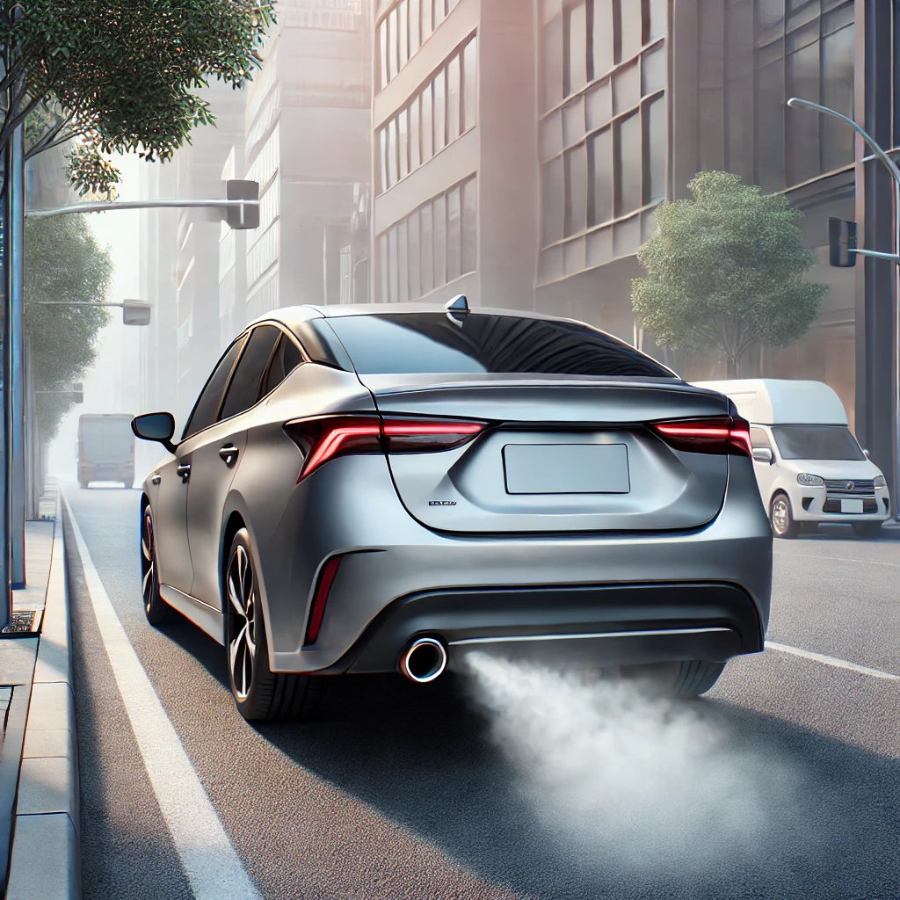
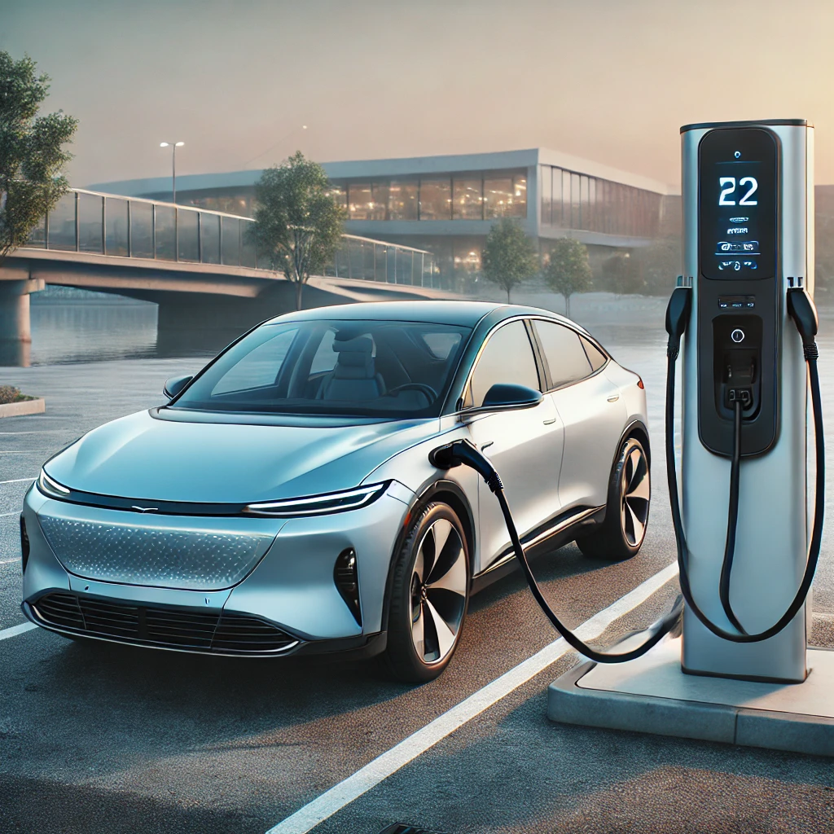
OVERVIEW
ICE vehicles powered by an engine that burns fossil fuels to produce the power needed to move the vehicle.
Electric Vehicles are powered by electric motors and use electricity stored in batteries as their primary energy source.
Environmental Impact
Fuel Dependency
Maintenance
Energy Efficiency
Performance
Zero Emissions & Less Noise Pollution
Energy Efficiency
Lower Operating Costs
Sustainability
Performance

Slide 5
BACKGROUND
India's EV market is experiencing significant growth, driven by
increasing consumer awareness on pollution,
government incentives, and
advancements in technology.
However, despite the growth, the overall penetration rate of EVs remains relatively low compared to the total vehicle market.
The industry is expected to continue its upward trajectory, with projections indicating a substantial increase in EV sales by 2030, driven by
policy support,
expanding charging infrastructure, and
increasing consumer preference for cleaner transportation alternatives.

Slide 6
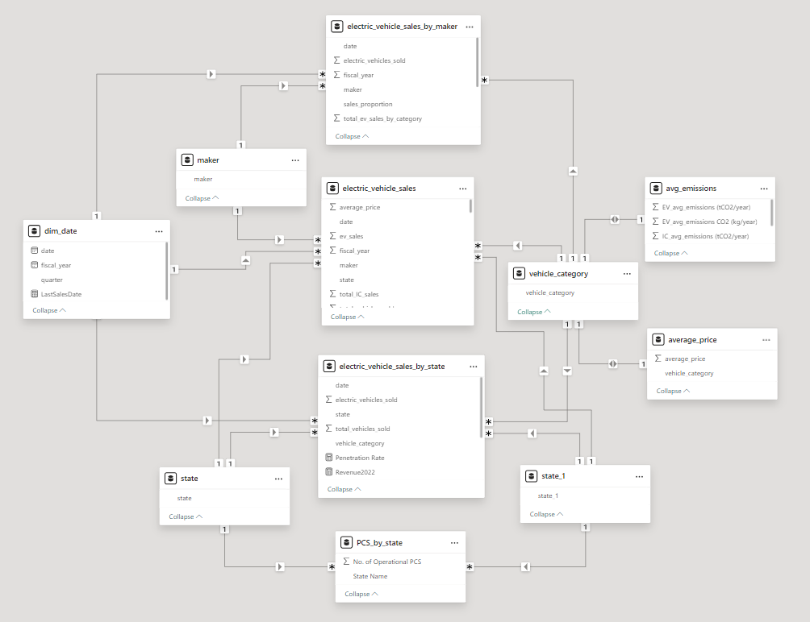
PROJECT OVERVIEW
Focus: Conduct a detailed analysis in Indian EV market highlighting trends and insights.
Datasets:
Date dimension,
Electric vehicle sales by state, and
Electric vehicle sales by maker
Data Model: Hybrid Schema
Data Completeness:
Merged "Andaman and Nicobar Island" with "Andaman and Nicobar" to ensure consistency and avoid confusion.
Assigned Andhra Pradesh data to both Telangana and Andhra Pradesh due to the absence of separate data for Telangana.

Slide 7
Key Notes:
Vehicle Category | Avg_price (₹) | Avg_ICE Emissions | Avg_EV Emissions
2- Wheelers | 85,000 | 0.4851 | 0.19
4- Wheelers | 10,00,000 | 2.4265 | 1.2825
Emission Reduction %
60.83% less
47.15% less
Emissions are in tC02/ year per vehicle

Slide 8
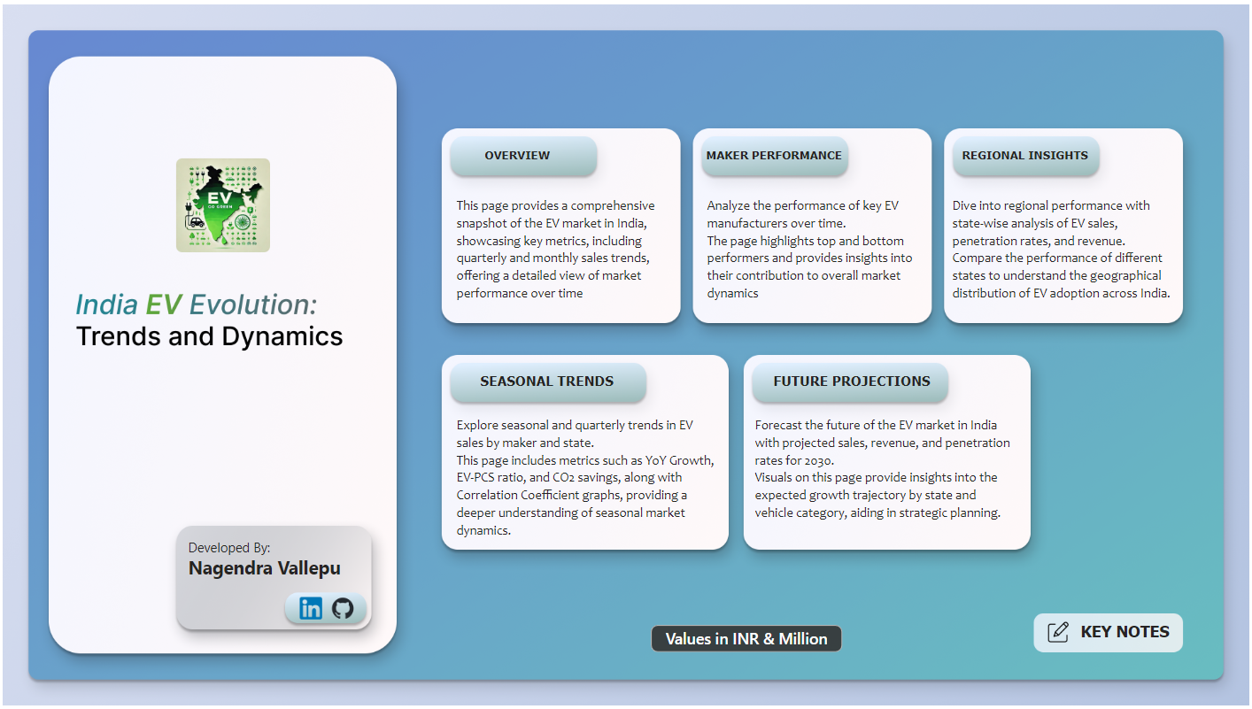
DASHBOARD

Slide 9
PRIMARY QUESTIONS

Slide 10
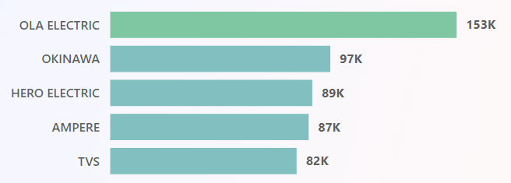
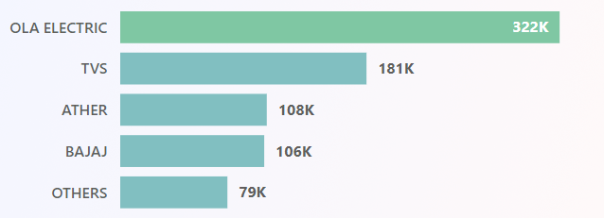
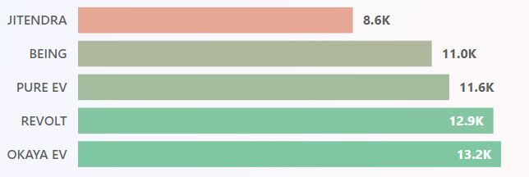
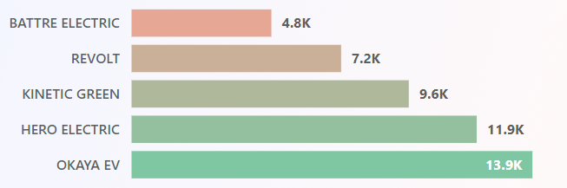
1. List the top 3 and bottom 3 makers for the fiscal years 2023 and 2024 in terms of the number of 2-wheelers sold.
2023
2024
Top 5 Makers
Top 5 Makers
Bottom 5 Makers
Bottom 5 Makers

Slide 11
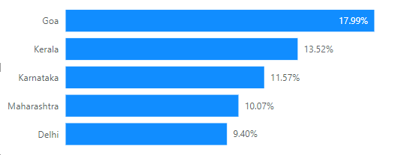
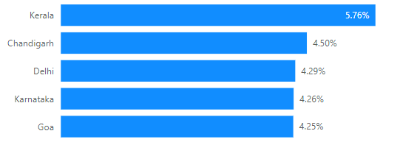
2. Identify the top 5 states with the highest penetration rate in 2-wheeler and 4-wheeler EV sales in FY 2024.
2- Wheelers
Penetration Rate
No. of EV’s sold
__________________________
No. of Total Vehicles Sold
4- Wheelers

Slide 12
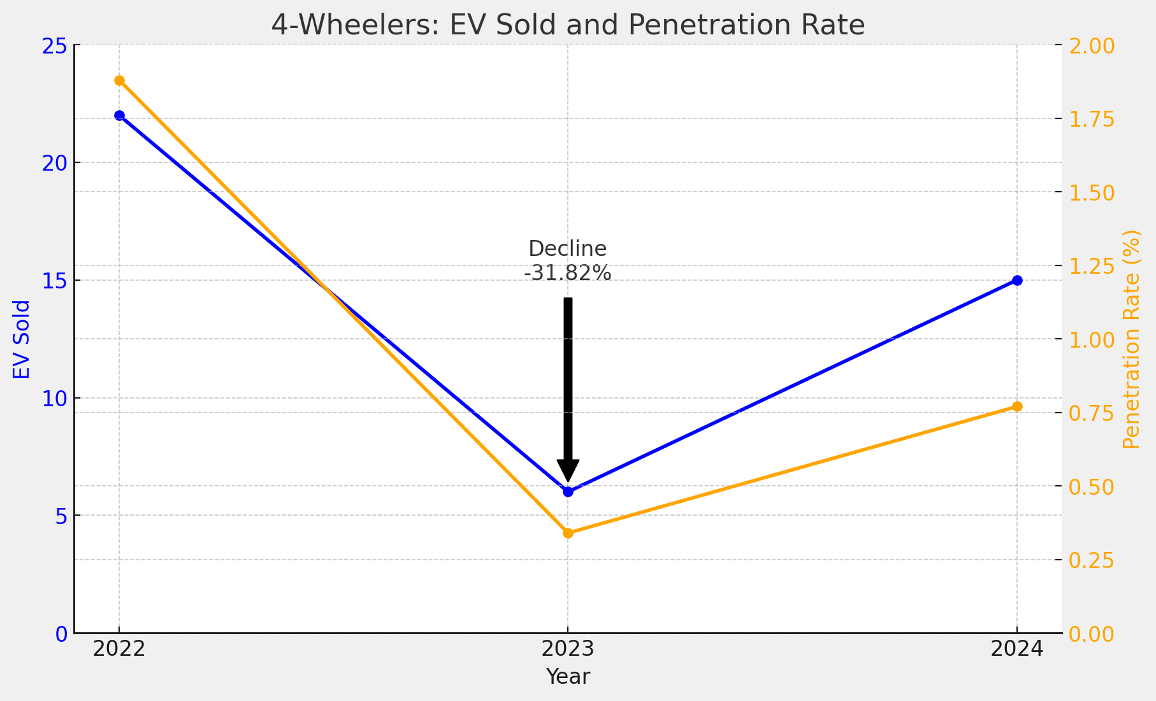
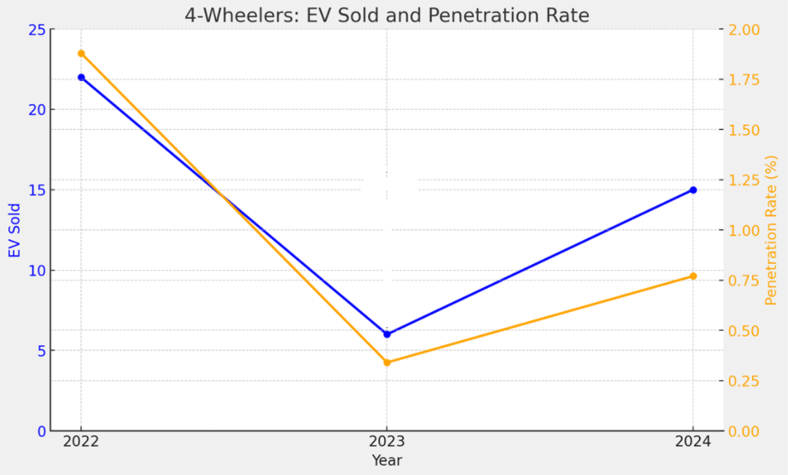
3. List the states with negative penetration (decline) in EV sales from 2022 to 2024
1.88%
Decline -31.82%
Andaman and Nicobar

Slide 13
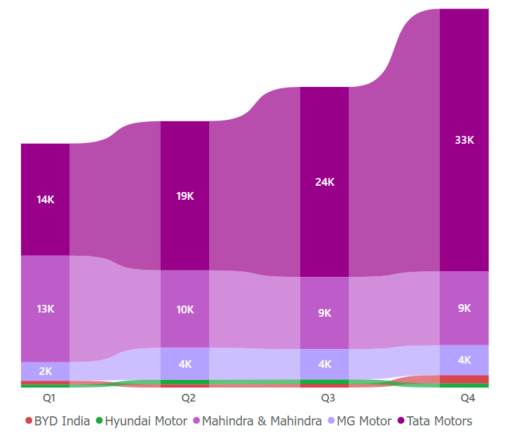
4. What are the quarterly trends based on sales volume for the top 5 EV makers (4-wheelers) from 2022 to 2024?
Tata Motors outperformed
their competitors in all quarters

Slide 14
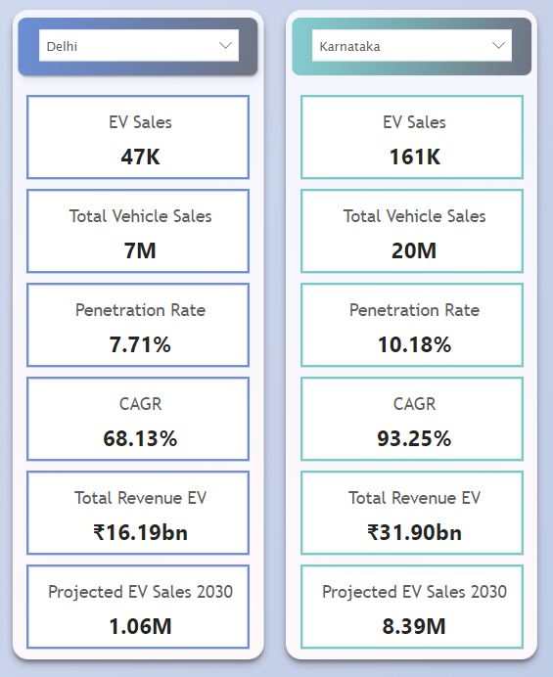
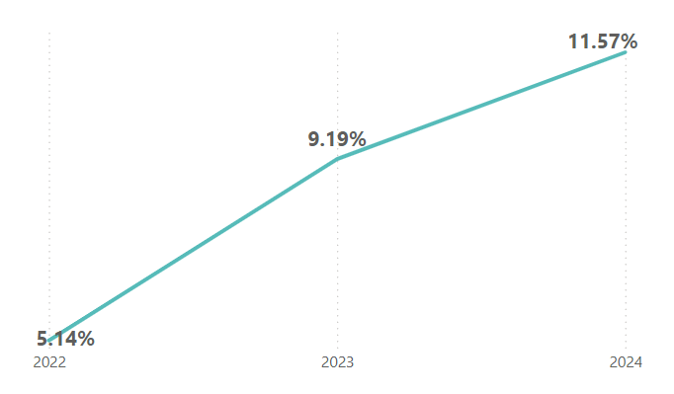
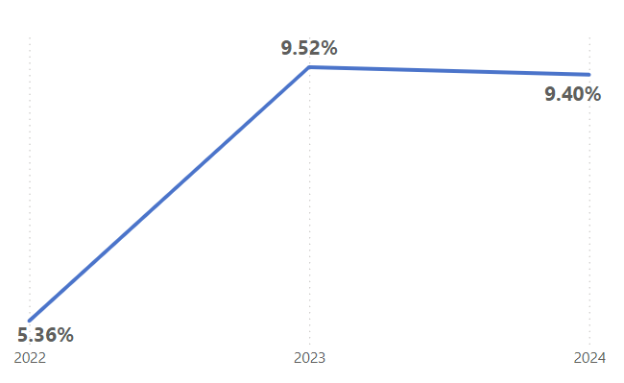

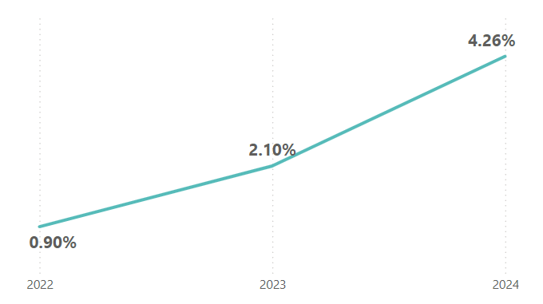
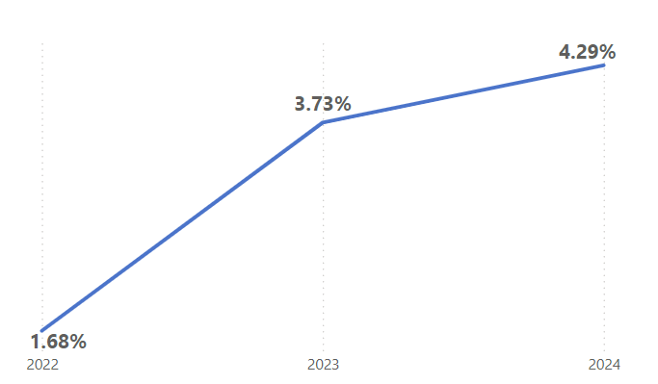

5. How do the EV sales and penetration rates in Delhi compare to Karnataka for 2024.

Slide 15
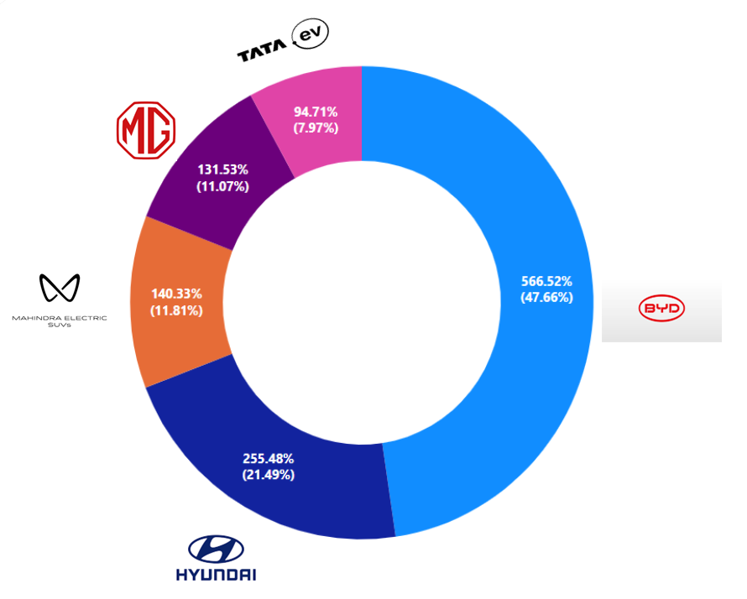
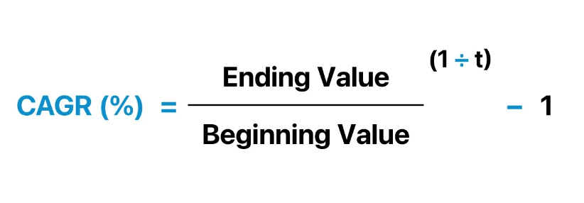
6. List down the compounded annual growth rate (CAGR) in 4-wheeler units for the top 5 makers from 2022 to 2024.
CAGR is mean annual growth rate for compounding values over a given time period.
Notes:
CAGR is not a return but a hypothetical representational figure.

Slide 16
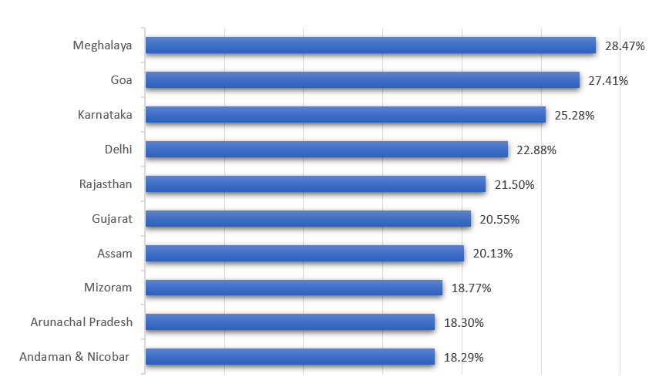
7. List down the top 10 states that had the highest compounded annual growth rate (CAGR) from 2022 to 2024 in total vehicles sold.
Notes:
Can be divided into 3 categories
>25% == Meghalaya, Goa, Karnataka
Between 20 and 25% == Delhi, Rajasthan, Gujarat and Assam
Less than 20% == Mizoram, Arunachal Pradesh, Andaman & Nicobar

Slide 17
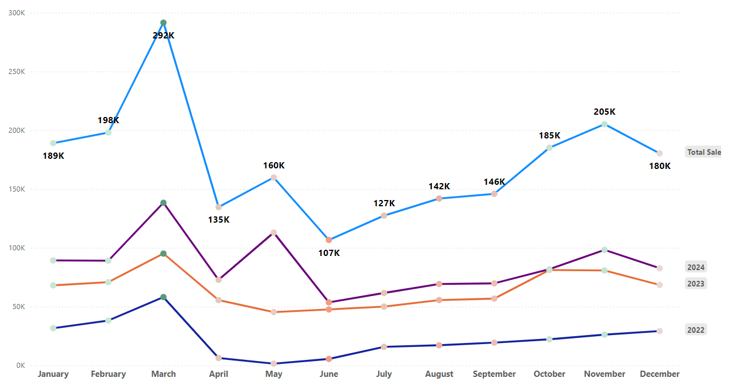
8. What are the peak and low season months for EV sales based on the data from 2022 to 2024
March is the Peak Month
June | July | April
Notes:
Sales are dipping by the end of Q1
Slowly picking up in Q2 & Q3
Peaking at end of Q4 at almost double of Q1

Slide 18
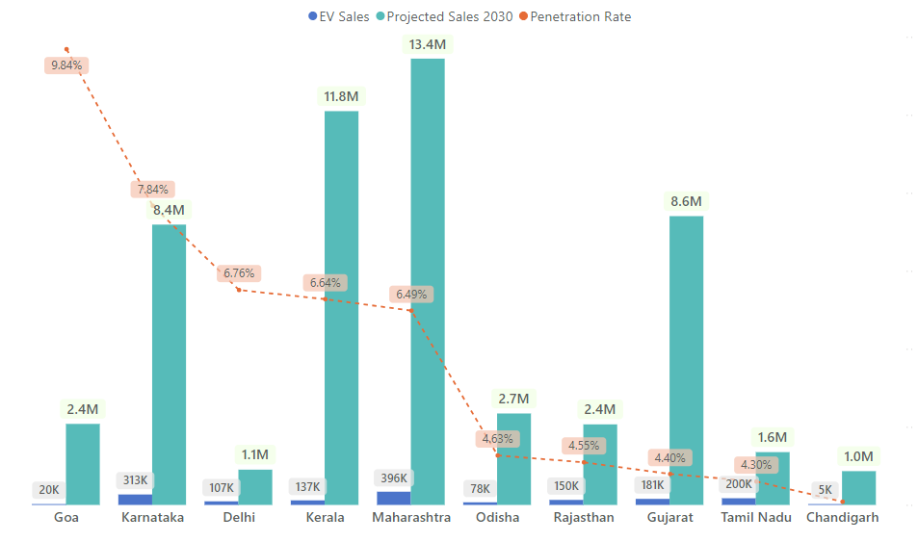
9. What is the projected number of EV sales (including 2-wheelers and
4-wheelers) for the top 10 states by penetration rate in 2030, based on the compounded annual growth rate (CAGR) from previous years?
Maharashtra, Kerala,
Karnataka, and Gujarat
Likely to be the key markets by 2030.
Goa has a strong adoption relative to its market size.
Odisha, Rajasthan, and Tamil Nadu
shows moderate Growth Potential.

Slide 19
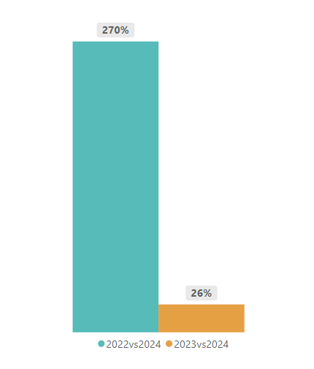
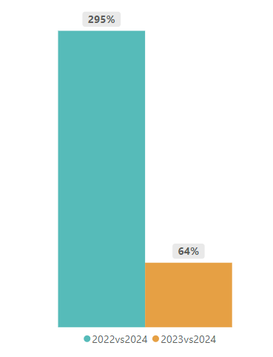
10. Estimate the revenue growth rate of 4-wheeler and 2-wheelers EVs in India for 2022 vs 2024 and 2023 vs 2024
2- Wheelers
4- Wheelers
Notes:
Revenue growth rate is slightly higher in 4 wheelers category compared to 2 –wheelers

Slide 20
SECNDARY QUESTIONS

Slide 21
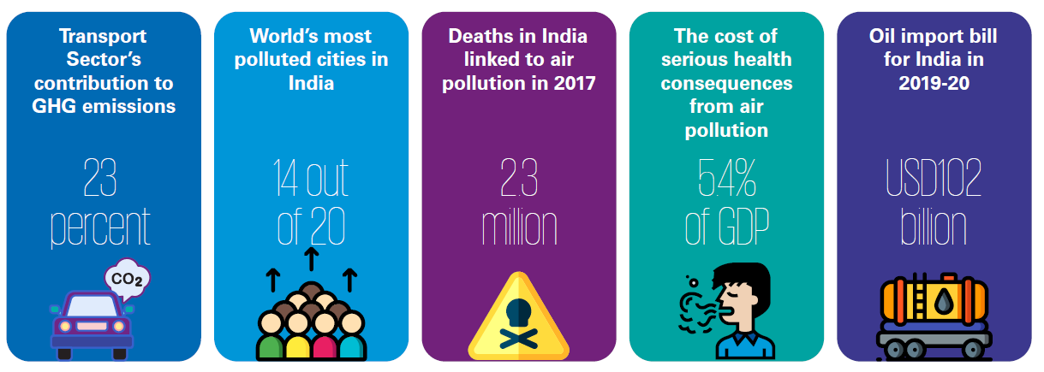
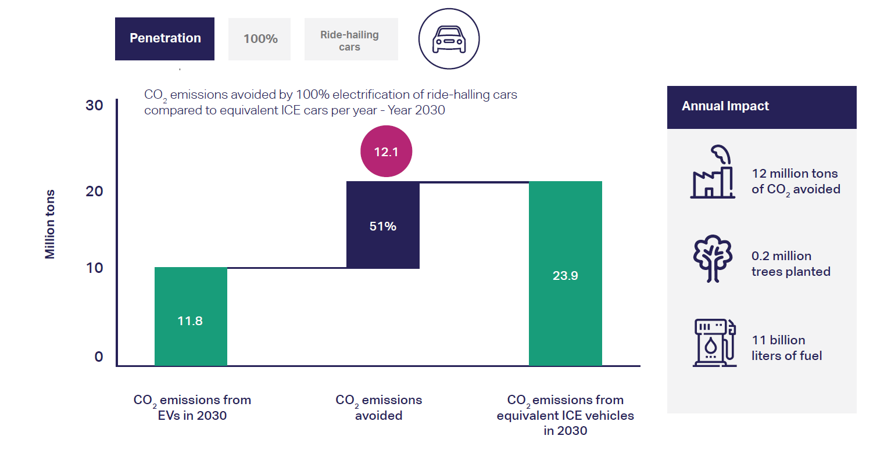
1. What are the primary reasons for customers choosing 4-wheeler EVs in 2023 and 2024
Environmental Concerns and Sustainability
12.1 Millions tons of CO2 emissions
CO2 emissions avoided (million tons) by electric cars compared to equivalent ICE fleet - 2030

Slide 22
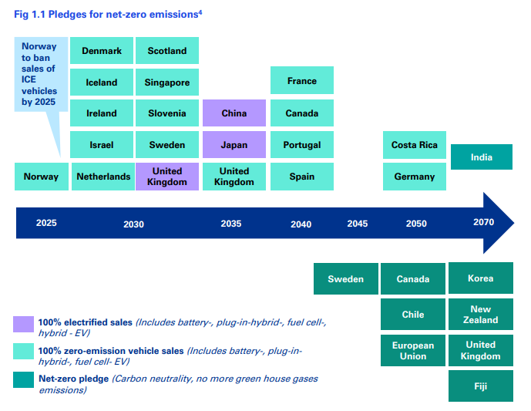
1. What are the primary reasons for customers choosing 4-wheeler EVs in 2023 and 2024
Government Policies & Infrastructure Development
State-level policies
FAME India Scheme Phase II
Electric Mobility Promotion Scheme (EMPS) 2024
Providing subsidies for 2W and 4W at cap of almost 40% of vehicle cost
Supply - side incentives
Andhra Pradesh
Uttar Pradesh
Tamil Nadu
Demand - side incentives
Delhi
Maharashtra
Karnataka
Goods & Services Tax (GST)
Petrol
48%
Expansion of Charging Infrastructure
Urban Policies Favouring EVs:
Dedicated Parking Spot
Lower Congestion charges
Certain Road TAX Exemptions
12%
18%
EV Vehicle
Charging
Stations
5%
Notes:
Faster Adoption and Manufacturing of Electric Vehicles
Supply-side incentives are measures taken by governments to encourage the production and supply of goods or services. These will benefit manufactures, producers or business involved in creation and distribution of Evs
Demand-side incentives are measures were targeted at customers encouraging them to purchase electric vehicles.
Why every country is promoting electric vehicles?
Because of the Global Climate Pledge which was undertaken by all countries to reduce the Emissions.

Slide 23
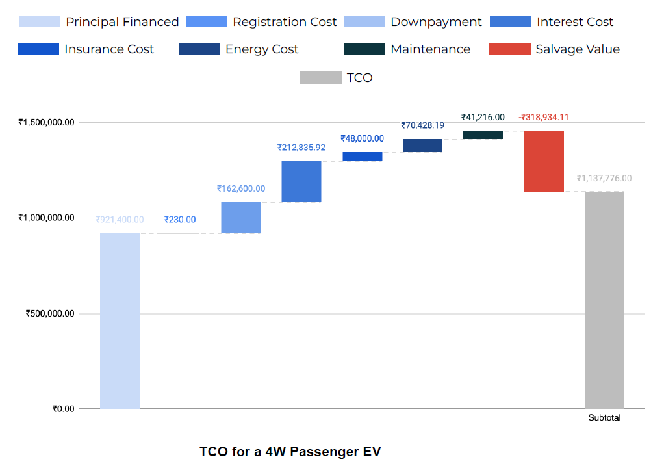
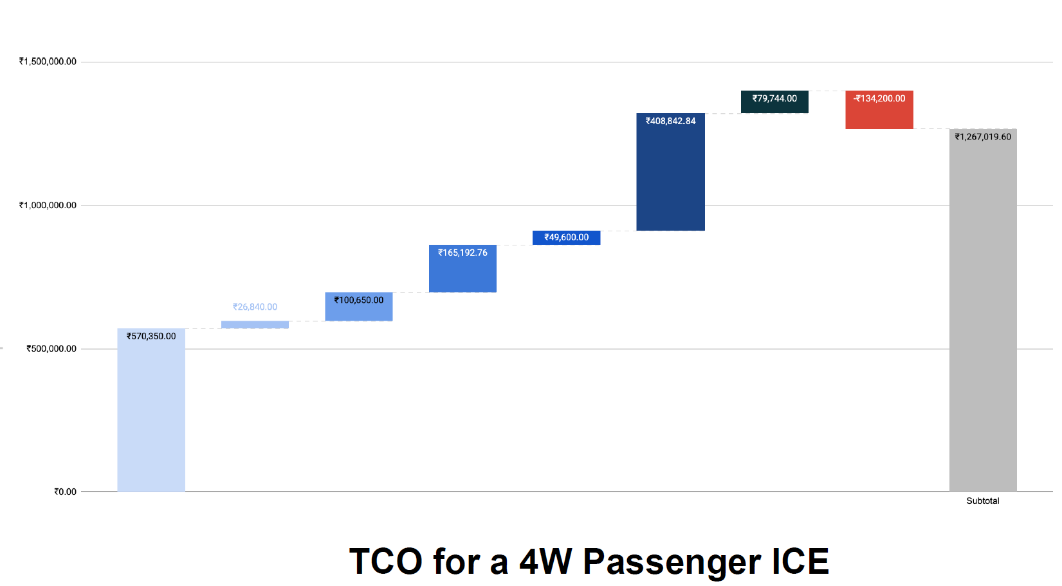
1. What are the primary reasons for customers choosing 4-wheeler EVs in 2023 and 2024
Cost Savings
Total Cost of Ownership (TCO) = Purchase Cost + Operational Costs
Electric Vehicle
ICE Vehicle
Vehicle Cost is the highest costs in the TCO of an EV
Energy is the highest cost in the TCO of an ICE
Vehicle usage to be 35 kms/day for 7 yrs
Notes:
Considering all these factors, Customers are choosing 4-wheeler EVs.

Slide 24
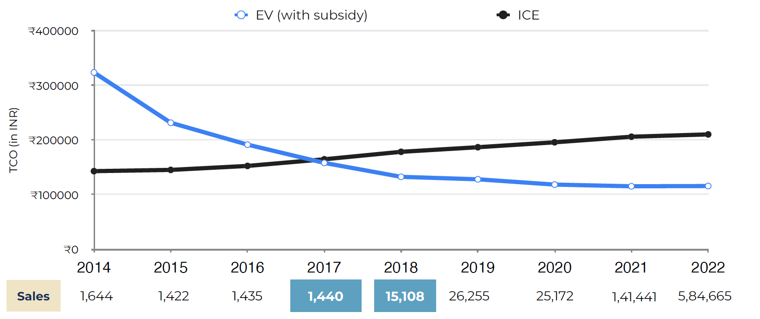
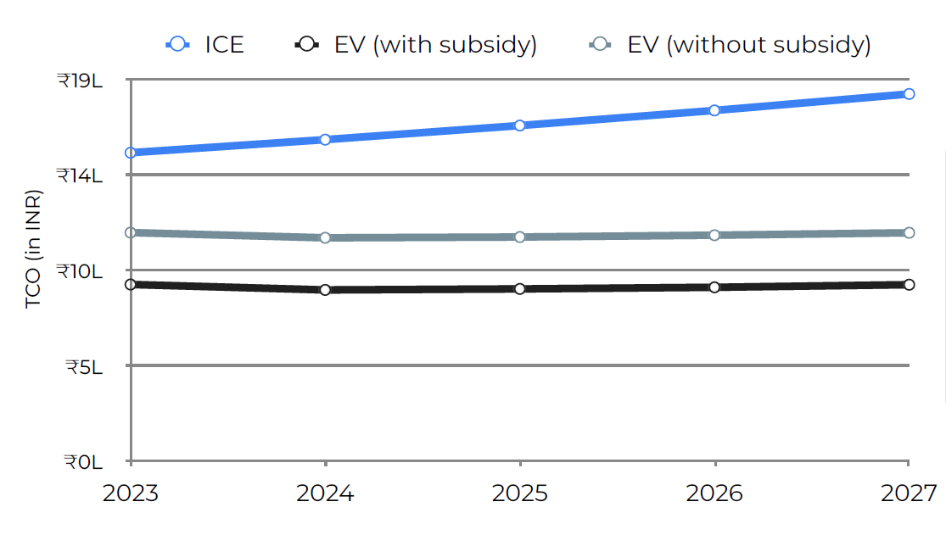
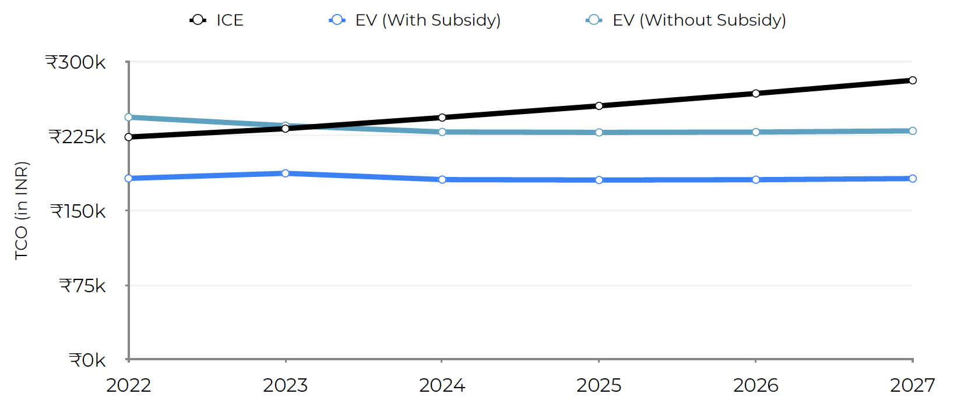
2. How do government incentives and subsidies impact the adoption rates of 2-wheelers and 4-wheelers?
Which states in India provided most subsidies?
TCO POSITIVE
4W Passenger in 2023 is TCO positive with and without subsidy due to availability of a smaller car and lower interest rates as compared to 2022 All
2W Passenger became TCO positive sometime in 2017-2018 with subsidy in place resulting in 10x jump in Sales
TCO positive in 2023 without any subsidy
155% Increase in Sales in 2023 compared to 2022
Notes:
If the Total Cost of Ownership is lower than an alternative segment of a product, then it is considered as TCO Positive

Slide 25
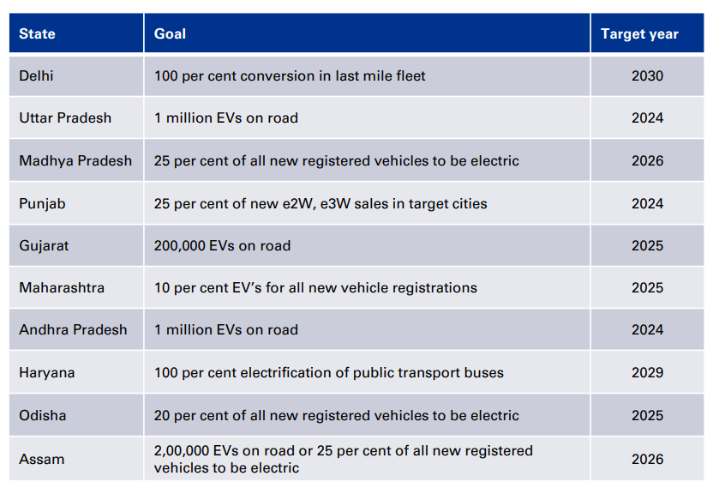
2. How do government incentives and subsidies impact the adoption rates of 2-wheelers and 4-wheelers?
Which states in India provided most subsidies?
Tamil Nadu
100% reimbursement of SGST on EV sales
100% electricity tax exemption
100% stamp duty exemption for EV-related transactions
Attracting large-scale investments worth INR 500 billion
EV Targets for State Governments
Maharashtra
Exemptions from road tax and registration
25% capital subsidy for commercial public charging stations
Attracting investments worth INR 250 billion
Karnataka
Offers interest-free loans on the net SGST
100% of land conversion fees reimbursement
Attracting investments worth INR 310 billion
Andhra Pradesh
100% on reimbursement on stamp duty & Electricity taxes
Reimbursement of SGST for companies
Financial assistance - 50 per cent of fixed capital investment

Slide 26
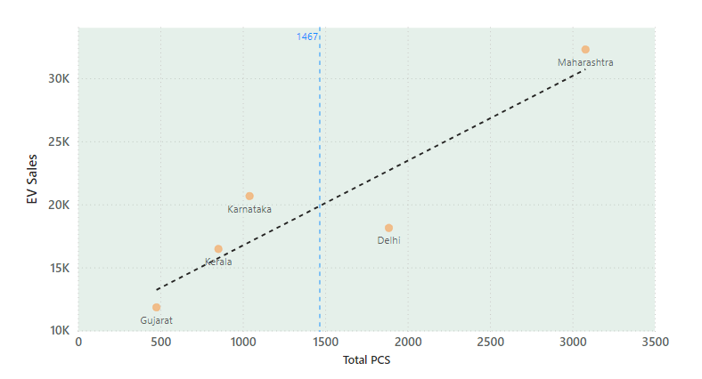
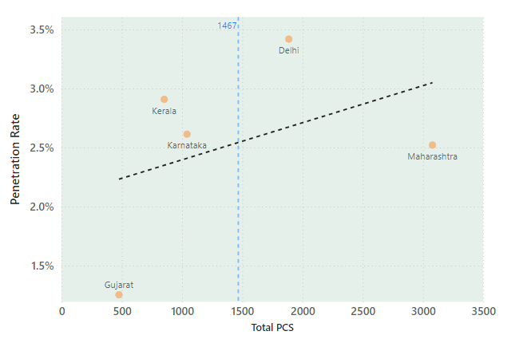
3. How does the availability of charging stations infrastructure correlate with the EV sales and penetration rates in the top 5 states?
vs EV Sales
vs Penetration Rate
CORR COEF = 0.91
CORR COEF = 0.63
CORR COEF = 0.82
CORR COEF = 0.54

Slide 27
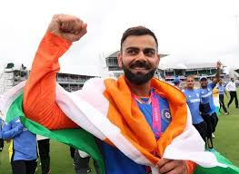

4. Who should be the brand ambassador if AtliQ Motors launches their EV/Hybrid vehicles in India and why?
Virat Kohli
Deepika Padukone
Mass Appeal
Credibility
Environmentally Conscious
Tech Savvy and Modern
Health and Fitness Enthusiast
Broad Appeal
Advocate for Mental Health
Elegance and Style
Female Representation

Slide 28
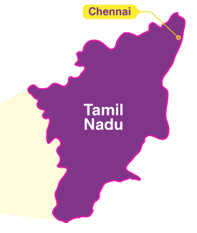
5. Which state of India is ideal to start the manufacturing unit?
Tamil Nadu
#3 – Ease of doing Business
Subsidies & Incentives
Infrastructure
Well established Automotive Sector
Industrial Policies & Clusters
Supply Chain
Export Opportunities
Technology & Innovation Ecosystem
TVS MOTORS
ASHOK LEYLAND
HYUNDAI MOTORS
RENAULT NISSAN
FORD INDIA BYD
PCA AUTOMOBILES (CITRON)

Slide 29
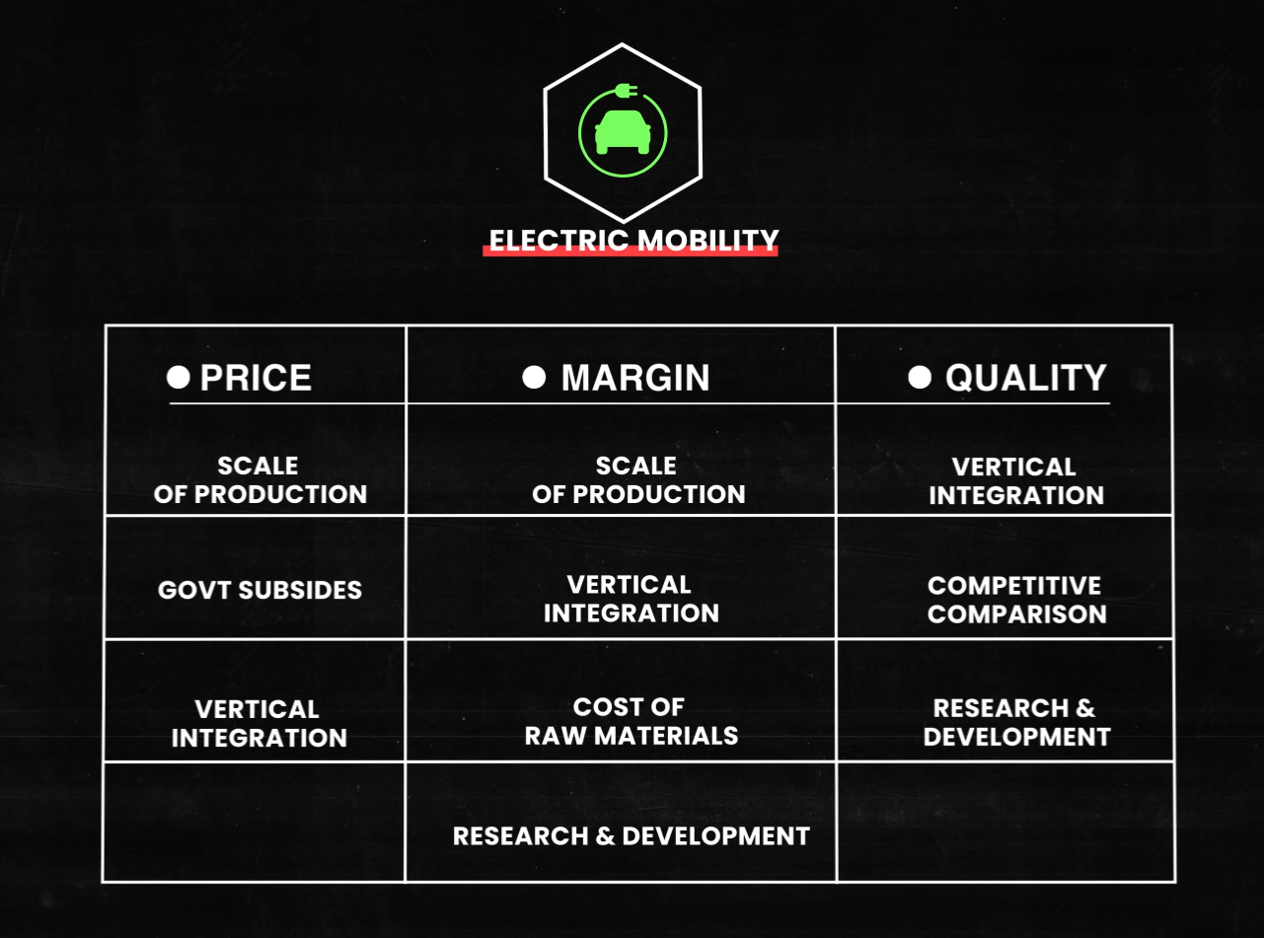

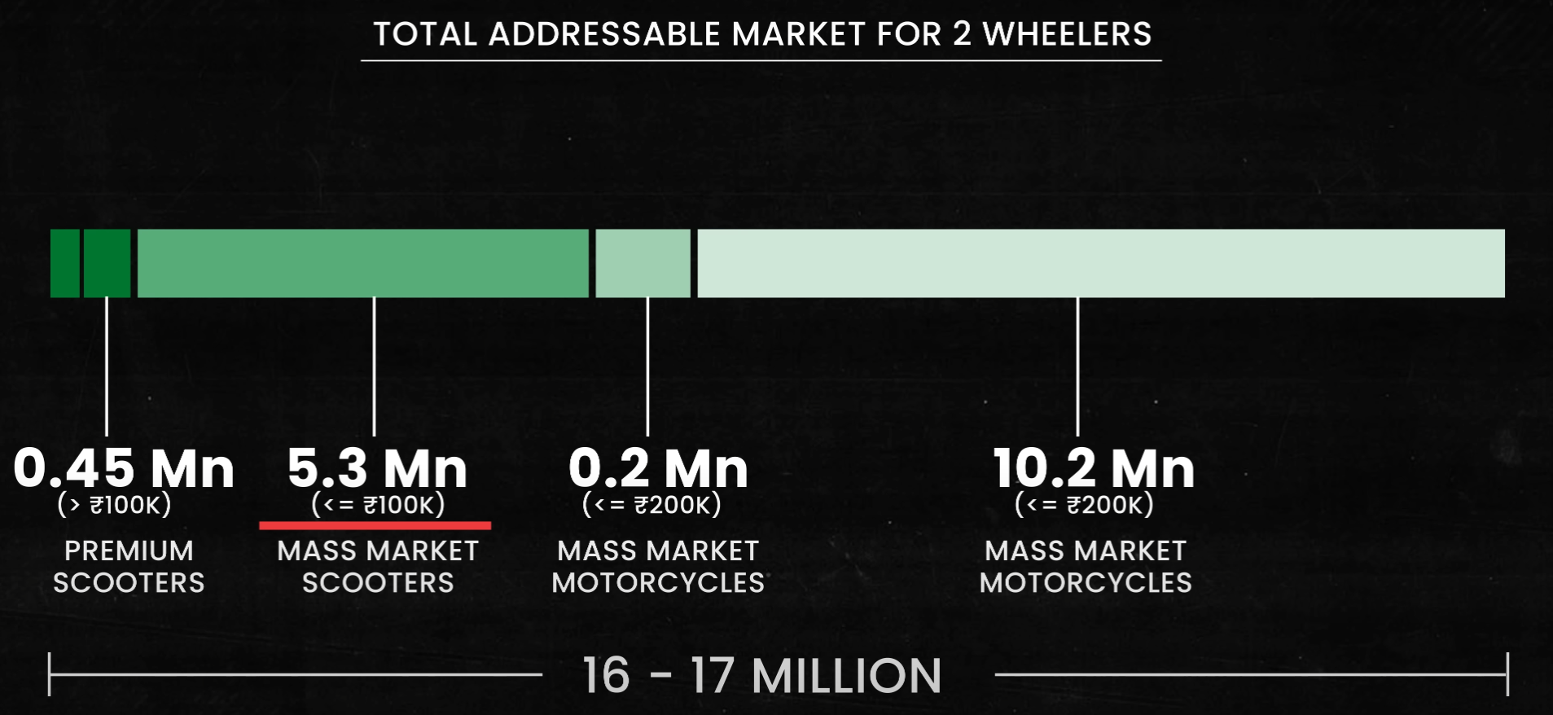
6. Top 3 recommendations for AtliQ Motors
Critical Variables in EV Market
Recommendations
Focus on High-Growth States for Market Entry and Expansion
PRICE
MARGIN
QUALITY
Leverage Technology and Data Analytics for Customer-Centric Offerings
Effective marketing &
Build a Strong Brand with Sustainability and Innovation as Core Values
10.8% of Total revenue
Building best EV vehicle doesn’t get you WIN.
but building a vehicle which outperforms ICE vehicles
on every level does.
Scooters ~ 10 times lesser, price> ₹ 100K
Bikes ~ 15 times lesser, price> ₹ 200K

Slide 30
REFERENCES
https://blume.vc/reports/the-road-to-electric-vehicles-a-primer-to-decode-the-ecosystem
https://assets.kpmg.com/content/dam/kpmg/in/pdf/2020/10/electric-vehicle-mobility-ev-adoption.pdf
https://assets.kpmg.com/content/dam/kpmg/in/pdf/2023/04/Technology-at-the-forefront-of-Electric-Vehicle.pdf
https://assets.kpmg.com/content/dam/kpmg/cz/pdf/2024/Getting%20real%20about%20the%20EV%20transition.pdf
https://blu-smart.com/assets/ev-report.pdf
https://pib.gov.in/PressReleaseIframePage.aspx?PRID=2003003
https://theicct.org/sites/default/files/publications/fuel-consumption-2w-india-aug2021.pdf

Slide 31




DHAVAL PATEL
Founder
@codebasics.io
HEMANAND VADIVEL
Co Founder & CEO
@codebasics.io
TEAM CODEBASICS
THINK SCHOOL
Notes:
Thank you

